Slide 1
State Channel
ontology

Slide 2
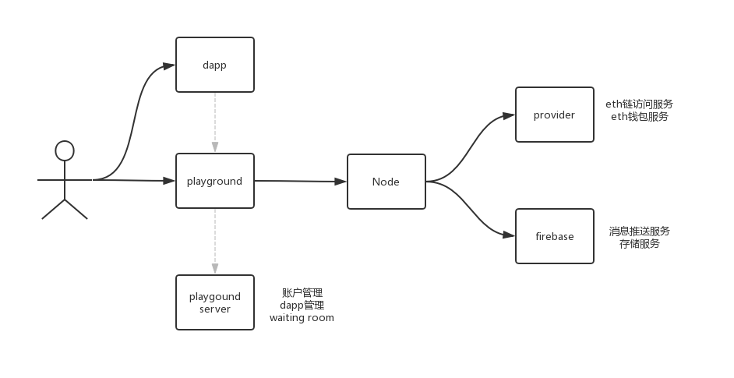
System Framework

Slide 3
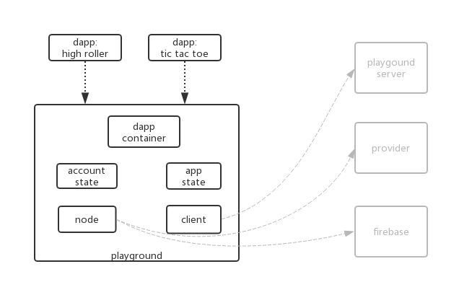
Playground Framework

Slide 4

Playground Server API

Slide 5


Use Case

Slide 6
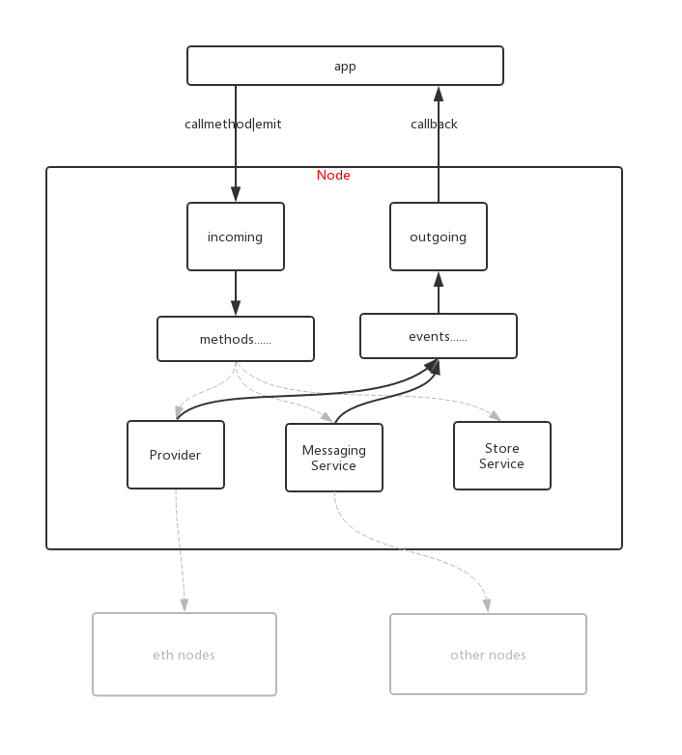
Node Framework

Slide 7


Use Case

Slide 8
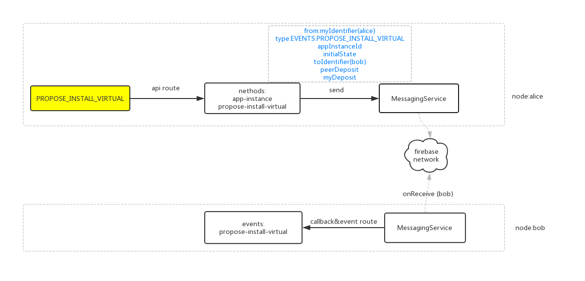
Use Case

Slide 9
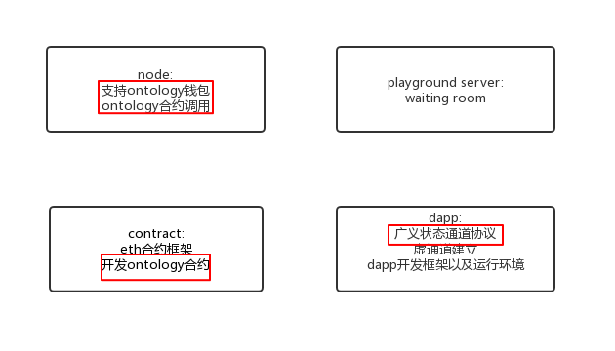
Ongoing work

